Slide 1
REQUIREMENTS ENGINEERING

Slide 2
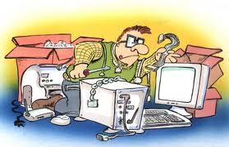
Software Requirements & Requirement properties

Slide 3

Generics
Is usually the first step in any software intensive development lifecycle irrespective of model
Usually difficult, error prone and costly
Critical for successful development of all down stream activities
Errors introduced during requirements phase if not handled properly will propagate into the subsequent phases
Unnecessary, Late or invalid requirements can make the system cumbersome or slip
Requirement errors are expensive to fix
V3.0 © 2011, IEEE All rights reserved

Slide 4
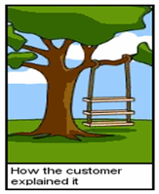
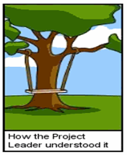
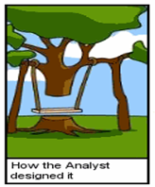
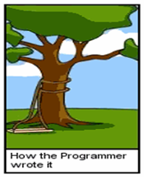

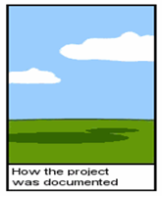
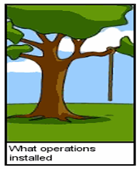
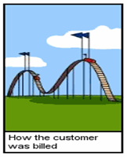
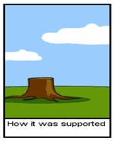
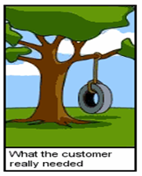
Cartoon on the Software Development

Slide 5
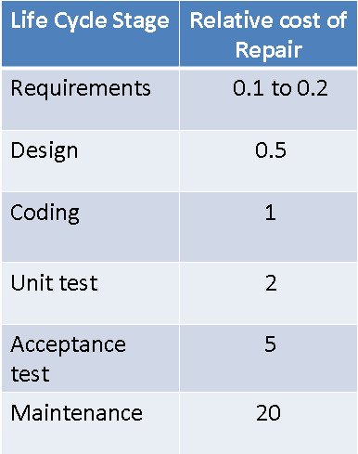
Cost of repair as a function of time
V3.0 © 2011, IEEE All rights reserved

Slide 6

Definition of Requirement
Requirement is the Property which must be exhibited by software developed/adapted to solve a particular problem
Requirement should specify the externally visible behavior of what and not how
Requirements can be looked at as
Individual requirements
Set of requirements
V3.0 © 2011, IEEE All rights reserved

Slide 7
Properties of Requirement
Prioritized - requirements should be prioritized
Consistent - No requirement should contradict another
Feasible – realizable with a specified time frame
Clear - Requirements should be written in precise, simple language that every reader can understand
Clear
Traceable – backwards to stakeholder request and forward to software components
Quantifiable - the requirement should be quantifiable, which aids in testing and verifying
Unambiguous - A requirement should have only one interpretation
Verifiable - requirement must have a clear, testable criterion and a cost-effective process to check it has been realized as requested
Quantifiable
Concise
Concise – Requirements should describe a single property and expressed with as few words as possible
Use Active Present Tense
Use Terminology Consistently
Avoid combining Requirements
Prioritized
Consistent
Individual Requirements
Verifiable
Unambiguous
Traceable
Feasible
V3.0 © 2011, IEEE All rights reserved

Slide 8
Examples
All screens must appear on the monitor quickly
or
When the user accesses any screen, it must appear on the monitor within 2 seconds (Clear – Concise - Unambiguous – Verifiable - Measurable)
The replacement control system shall be installed with no disruption to production
or
The replacement control system shall be installed causing no more than 2 days of production disruption
(Feasible)

Slide 9
Examples
The system must generate a batch end report and a discrepancy report when a batch is aborted
or
The system must generate a batch end report when a batch is completed or aborted
The system must generate a discrepancy report when a batch is aborted.
(Traceable)
The system must be user friendly
or
The user interface shall be menu driven. It shall provide dialog boxes, help screens, radio buttons, dropdown list boxes, and spin buttons for user inputs
(Verifiable)

Slide 10
Properties of a set of Requirement
The goals that are represented by the requirements should be attainable within the time, resource, and cost constraints placed upon the project.
When there are many requirements but limited time or budget, choices must be made about what to include or exclude. Factors such as changes in customer needs, improved developer understanding of the products, and changes in organizational policy will affect the stability of requirements.
Sets of Requirements
Realistic
Complete
Correct
Modifiable
Ranked for Importance or Stability
All the services that are needed from the system should be included
Changes to the requirements should be able to be made easily, completely, and consistently while retaining the structure and style.
Every requirement should be one that the software will meet
V3.0 © 2011, IEEE All rights reserved

Slide 11
Feasibility Study

Slide 12
Feasibility Study
Mostly done before beginning a project, a short, low-cost study to identify.
Project Identification
Feasibility
Study
REQUIREMENTS
ENGINEERING
Feasibility
Report
Approval

Slide 13
Activities in Feasibility Study
Client or the sponsor or the User who would have a stake in the project
What is the current solution to the problem
Who are the targeted customers and what is the future market place
Potential benefits : What would be gained by doing this project
Scope : A high level “what is included and what is not included” (This mostly includes High-level abstract description of the requirements)

Slide 14
Activities in Feasibility Study
High level block Level understanding of the solution
Considerations to technology
Marketing strategy
Financial projection
Schedule and high level planning and budget requirements
Issues, Assumptions, Risks and Constraints
Alternatives and their consideration
Potential project organization
Will end with a go or No-go Decisions

Slide 15
Requirements Engineering Process

Slide 16
Requirements Engineering process
There are “four + one” sets of activities that have been used, and have shown to produce specifications or requirements
Iterative Process
Requirements Elicitation
Requirements Analysis
Requirements Specification
Requirements Validation
Requirements Management
STEP 1
STEP 2
STEP 3
STEP 4
Requirements specification – process of creating of software and system specification documents suitable for use in further designing the software and in maintaining it
Requirements elicitation - process of gathering and discovering requirements
Requirements analysis - process of reviewing the requirements - which classifies the requirements, models the requirements, allocates them to a architectural design of the software and performs any tradeoffs and negotiations between the stakeholders
Requirements validation - help ensure that the right requirements are realized
- process of set of formal and informal reviews that will help ensure that the requirements when realized will meet the customer’s needs under the specified operating environment
- also uses modeling, prototypes and ultimately acceptance testing of the final product to verify and validate the correctness of the requirements
The project manager plans and drives this entire activity
V3.0 © 2011, IEEE All rights reserved
16

